Slide 1
Compilers 101
MLIR - Part 2

Slide 2
Previously
MLIR overview
MLIR practical applications

Slide 3
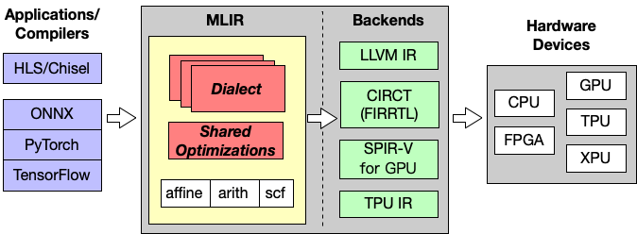
MLIR
http://lastweek.io/notes/MLIR/

Slide 4
Today
Available transformations and optimizations overview
Custom dialects
Writing a pass
MLIR connections with other languages
Debugging

Slide 5
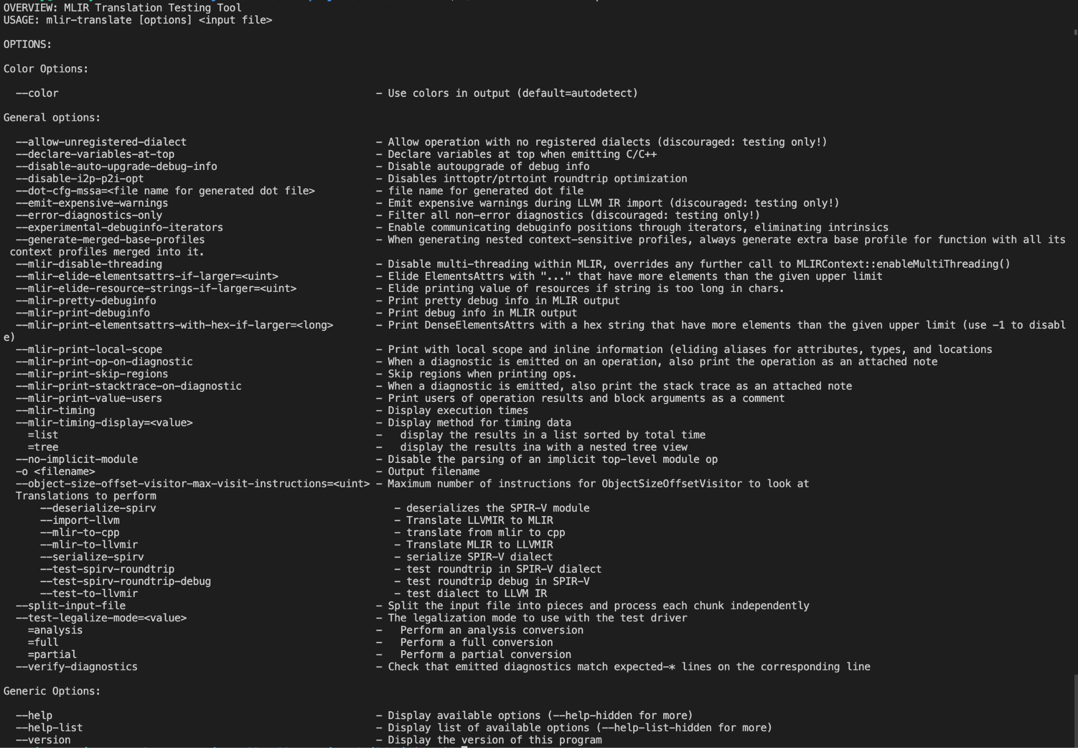
mlir-translate
Translate MLIR to…
LLVM
SPIR-V
C++
Input: MLIR
Output: target representation
List of targets: https://github.com/llvm/llvm-project/tree/main/mlir/lib/Target

Slide 6

mlir-opt
Responsible for optimizing MLIR code
Allows to run passes on MLIR
Input: MLIR
Output: MLIR
Help:
https://godbolt.org/z/x5zjxbq4T

Slide 7
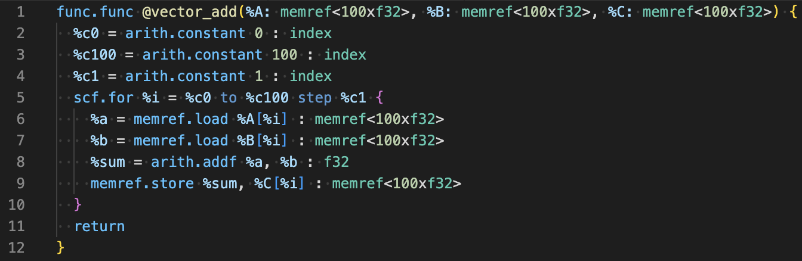
mlir-opt + mlir-translate
opt
https://godbolt.org/z/75a8xTrGx
translate
Example:
Translate the following code to LLVM IR
https://godbolt.org/z/z9s9q1x1P
convert to LLVM dialect
translate MLIR with LLVM dialect to LLVM IR

Slide 8
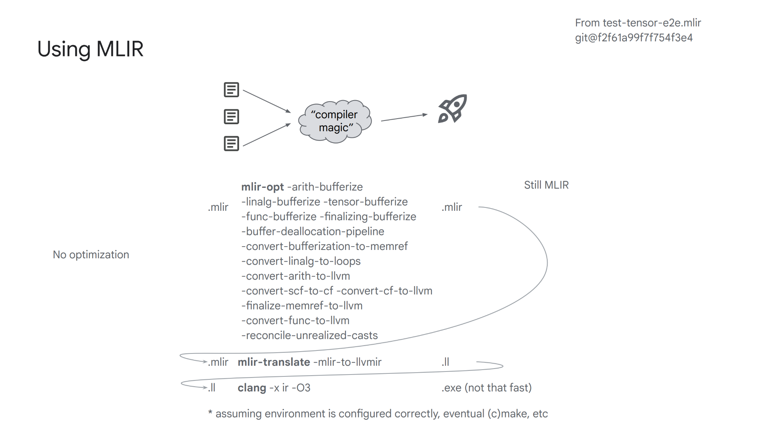
Source: https://llvm.org/devmtg/2023-10/slides/techtalks/Zinenko-MLIRisNotAnMLCompiler.pdf

Slide 9
Content
Available transformations and optimizations overview
Custom dialects
Writing a pass
MLIR connections with other languages
Debugging

Slide 10
Rewind back to LLVM IR
LLVM IR passes classifications
Types
Analysis pass
Transformation pass
Utility pass
Run scope
Module pass
Function pass
Loop pass
…
What about MLIR classification?
It could be the same
but in addition to that usually people outline different classification rules

Slide 11
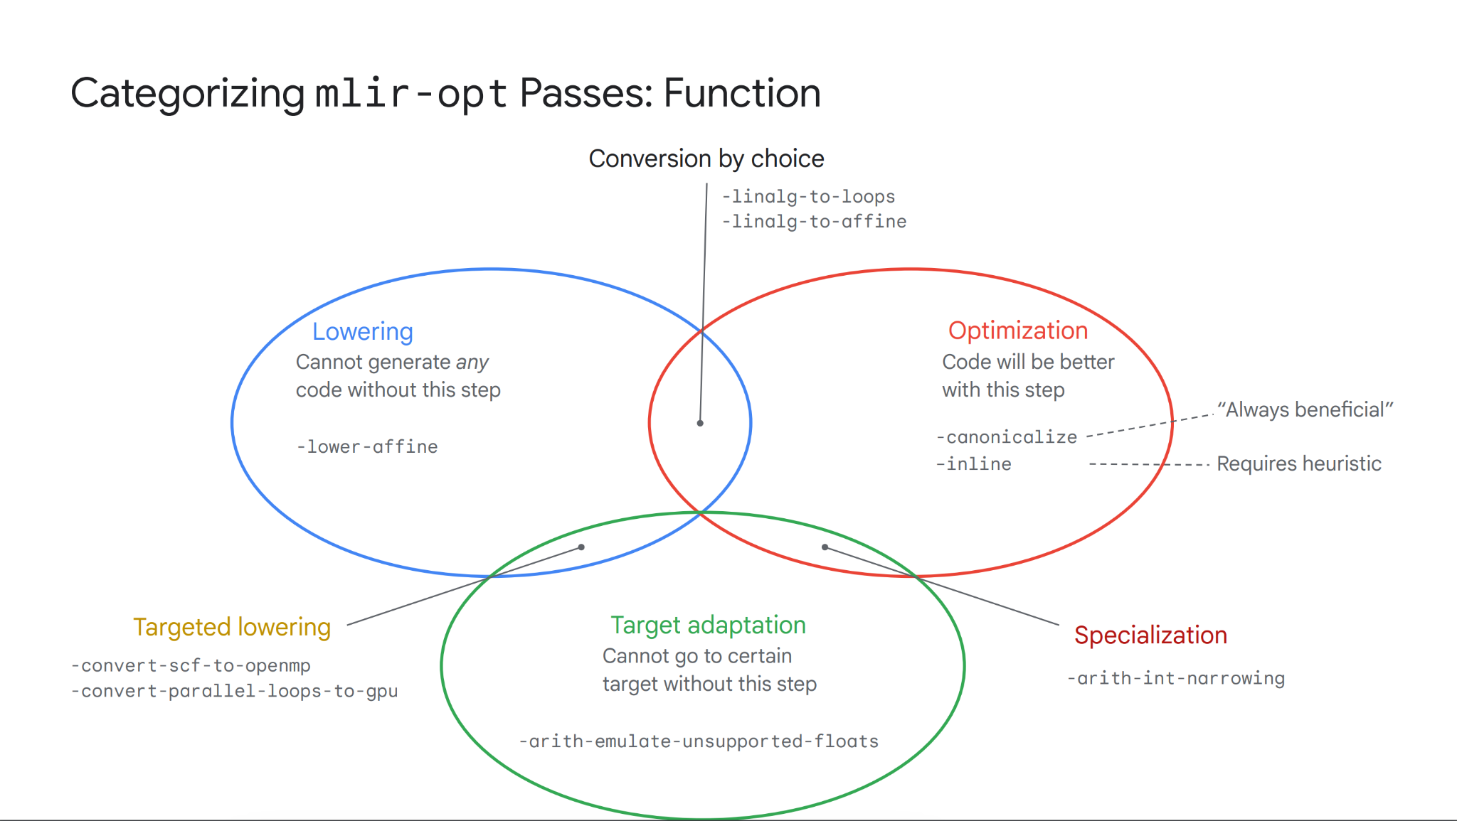
https://llvm.org/devmtg/2023-10/slides/techtalks/Zinenko-MLIRisNotAnMLCompiler.pdf

Slide 12
Available transformations
Reference page:
https://mlir.llvm.org/docs/Passes/

Slide 13
Lowering
Lowering is the process of transforming a high-level representation of a program into a lower-level representation
Lowering involves transforming this high-level representation into a more concrete, lower-level representation that is closer to the target hardware's capabilities and constraints.
One of common lowering pipelines:
ML framework/DSL -> (TOSA) -> Linalg -> Affine -> SCF -> LLVM -> LLVM IR

Slide 14
Lowering
http://lastweek.io/notes/MLIR/
One of common lowering pipelines:
ML framework/DSL -> (TOSA) -> Linalg -> Affine -> SCF -> LLVM -> LLVM IR

Slide 15
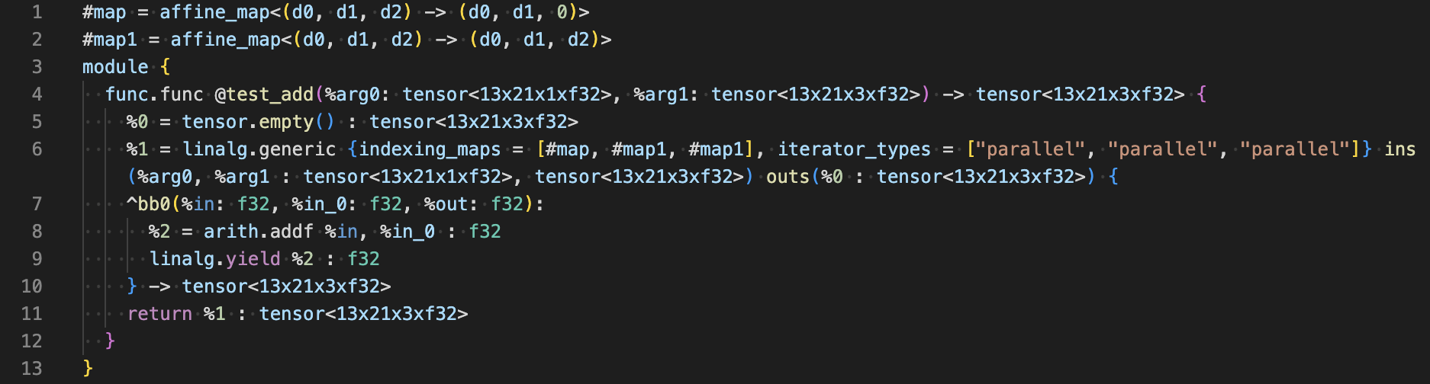
TOSA to Linalg
https://godbolt.org/z/T9G4zPb99
https://github.com/llvm/llvm-project/blob/76aa042dde6ba9ba57c680950f5818259ee02690/mlir/test/Dialect/Tosa/ops.mlir#L226C12-L226C20
mlir-opt -pass-pipeline="builtin.module(func.func(tosa-to-linalg))"

Slide 16
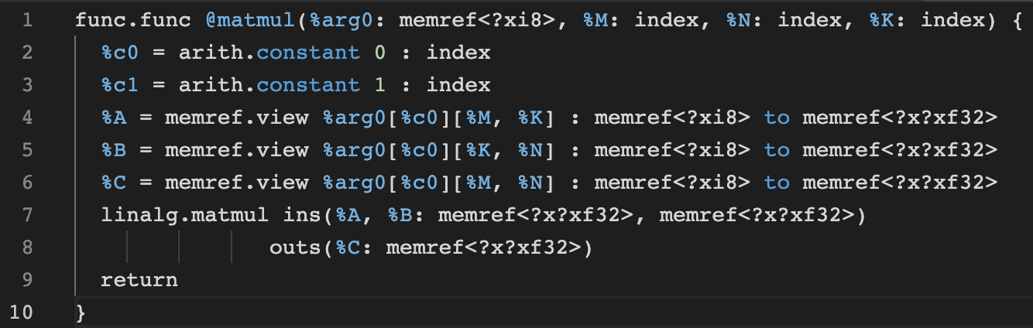
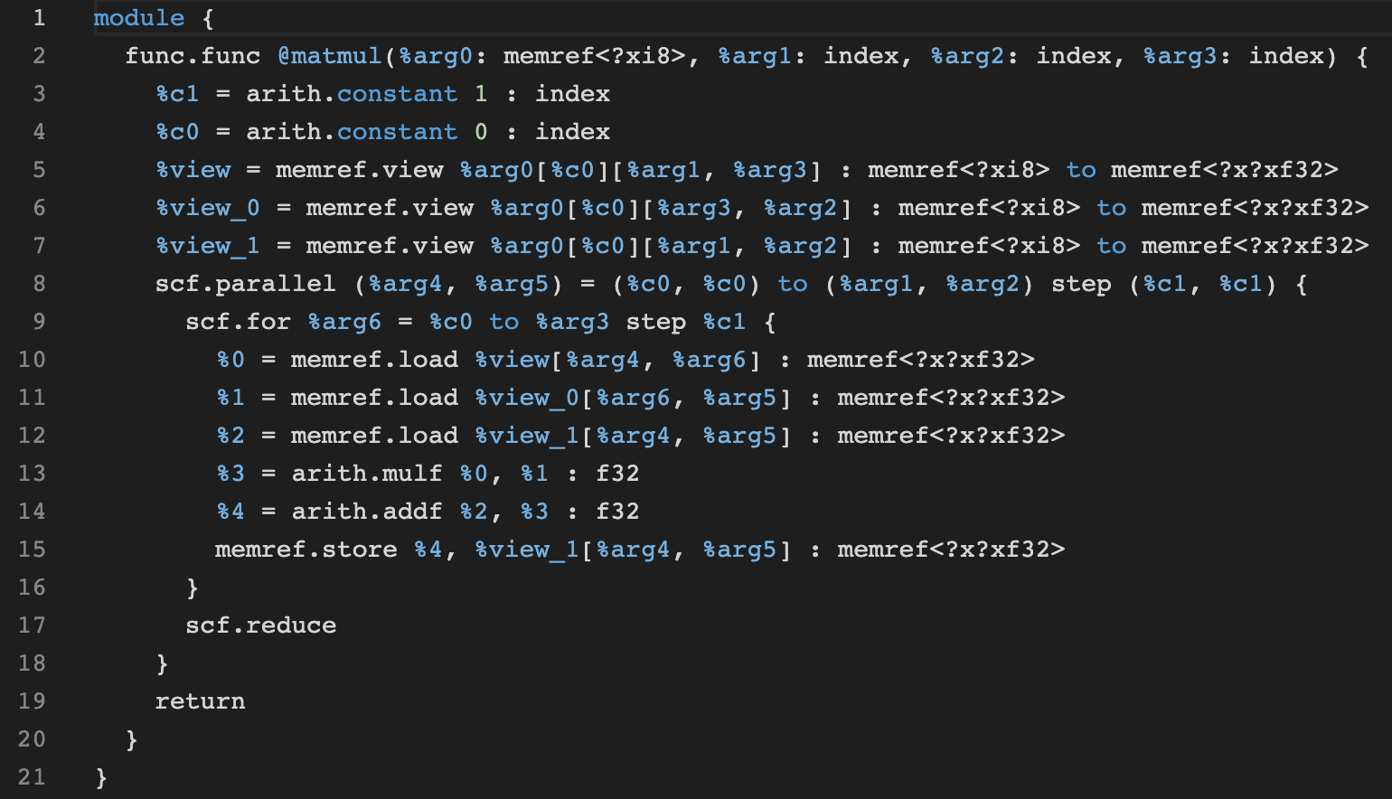
Linalg conversion to parallel loops
https://github.com/llvm/llvm-project/blob/76aa042dde6ba9ba57c680950f5818259ee02690/mlir/test/Dialect/Linalg/affine.mlir#L6
mlir-opt -pass-pipeline="builtin.module(func.func(convert-linalg-to-parallel-loops))"
https://godbolt.org/z/b3jjfhx6j

Slide 17
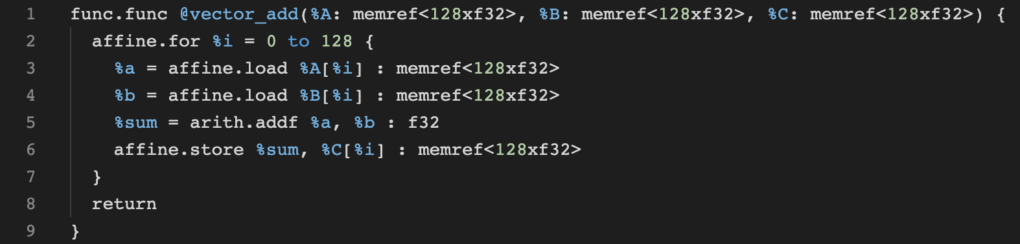
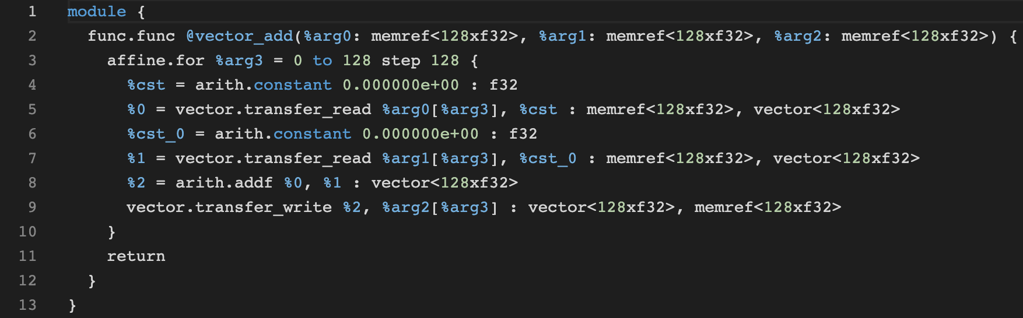
Affine loops vectorization
https://godbolt.org/z/T3q1qzxqc
mlir-opt -affine-super-vectorize=virtual-vector-size=128

Slide 18
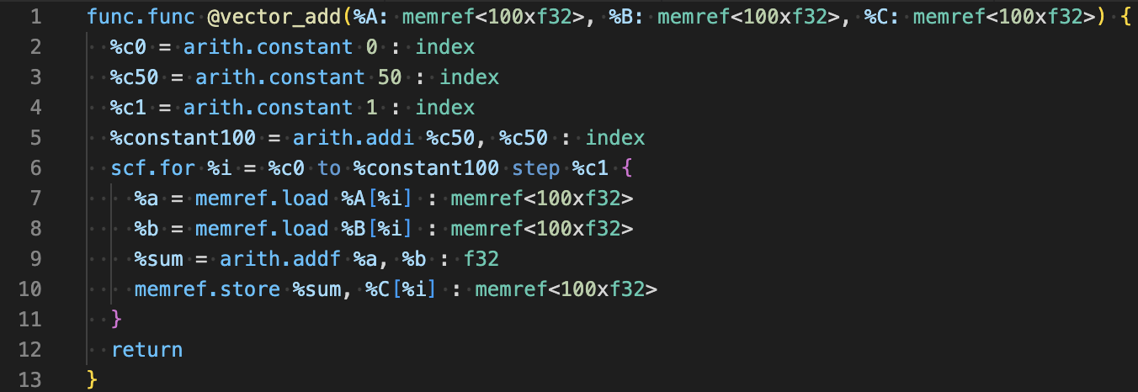
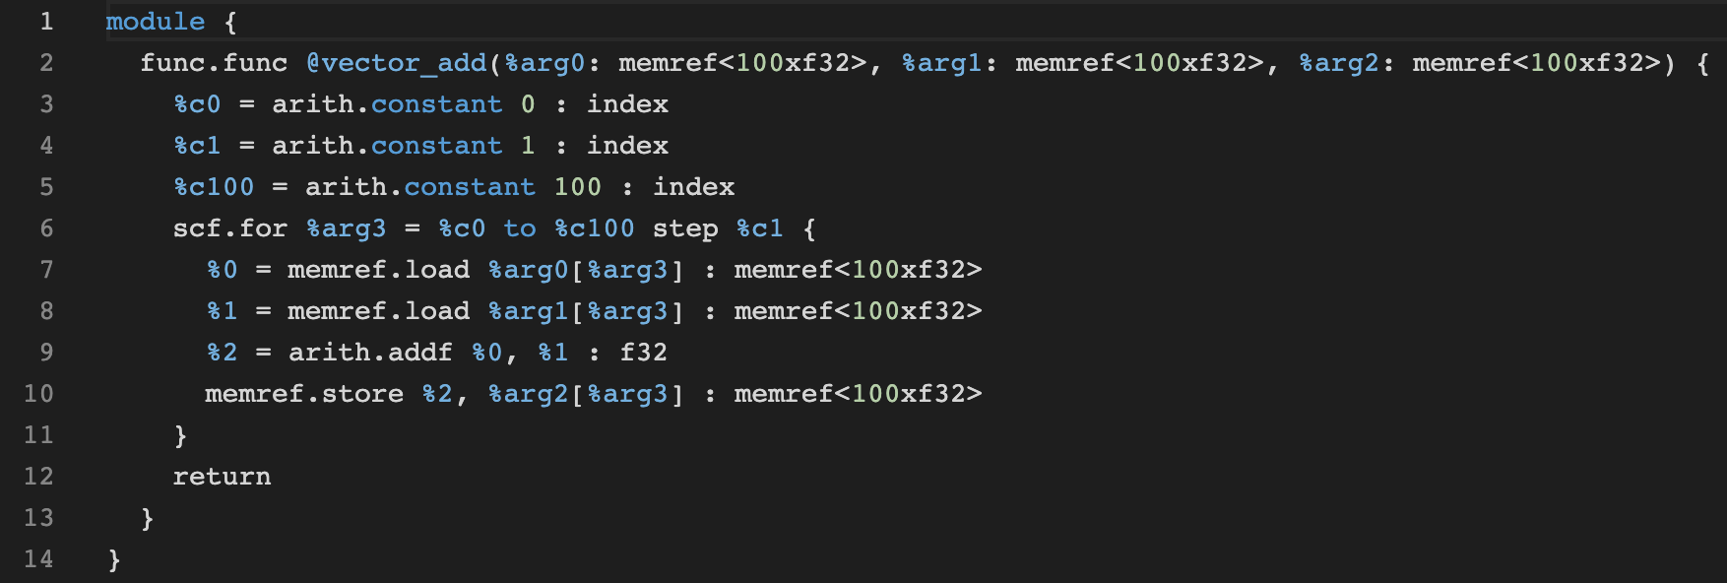
Canonicalizer
https://godbolt.org/z/Yd47xj6df
The purpose of the canonicalizer - transform MLIR code into a canonical form (to a standardized, simplified representation of code that allows for easier analysis and optimization)
Canonicalization is an important part of compiler IR design: it makes it easier to implement reliable compiler transformations and to reason about what is better or worse in the code, and it forces interesting discussions about the goals of a particular level of IR. Dan Gohman wrote an article exploring these issues; it is worth reading if you’re not familiar with these concepts.
From https://mlir.llvm.org/docs/Canonicalization/

Slide 19
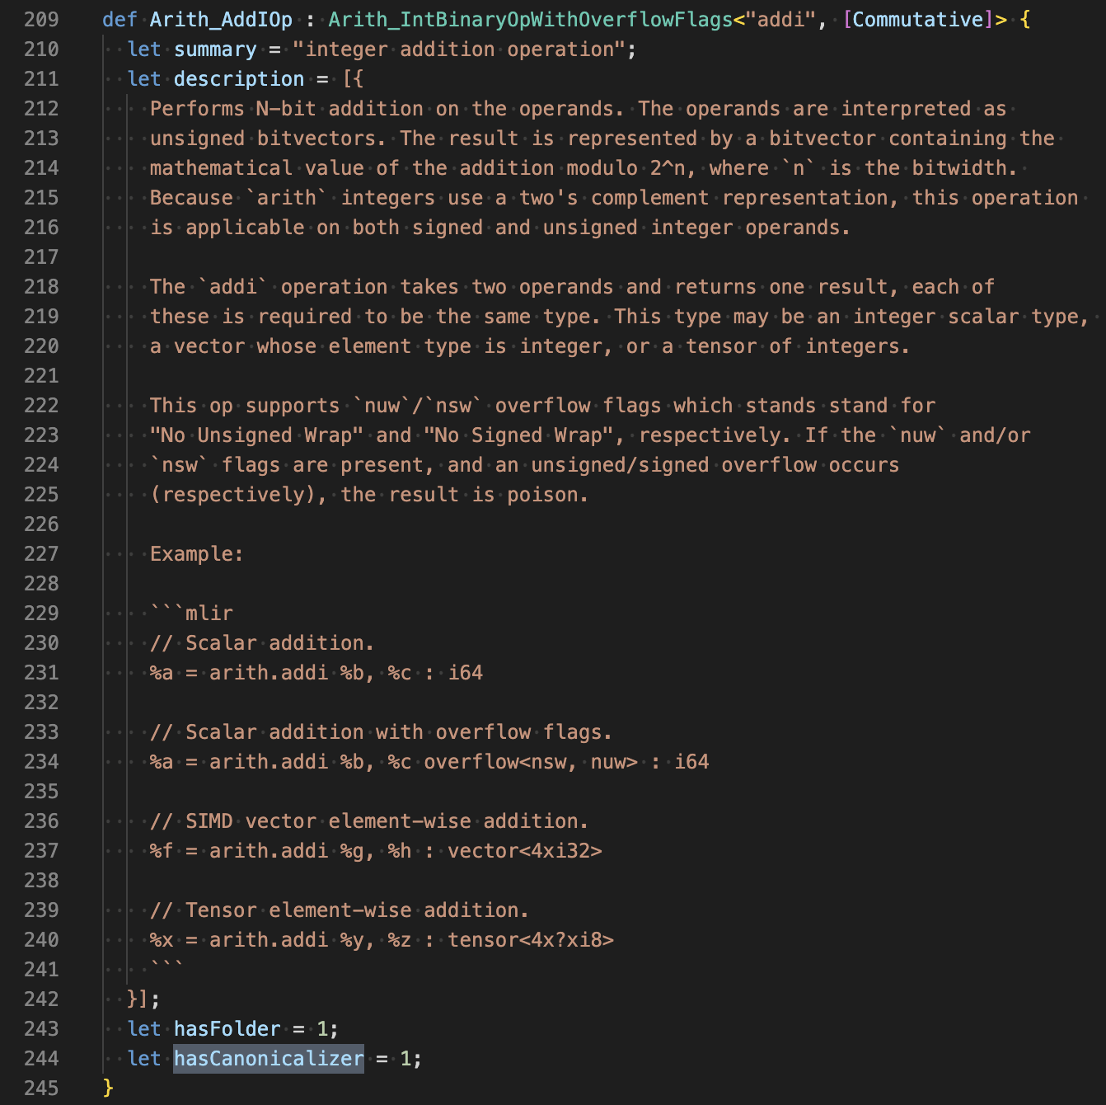
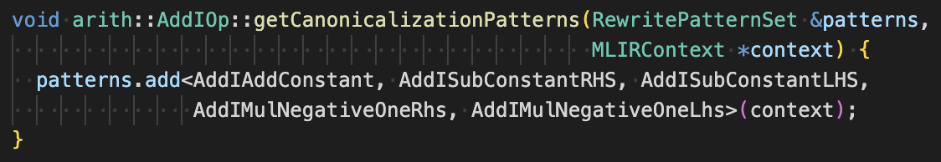
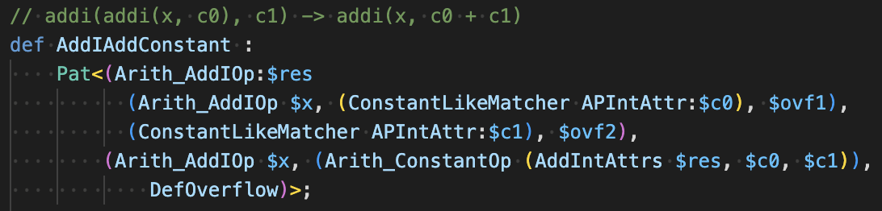
Canonicalization patterns
https://github.com/llvm/llvm-project/blob/7a484d3a1f630ba9ce7b22e744818be974971470/mlir/include/mlir/Dialect/Arith/IR/ArithOps.td#L244
How canonicalizer understands what to optimize?
https://github.com/llvm/llvm-project/blob/02dfbbff1937b3e2c1ee1cd4a5ad0a9f03ee23ea/mlir/lib/Dialect/Arith/IR/ArithOps.cpp#L319-L323

Slide 20
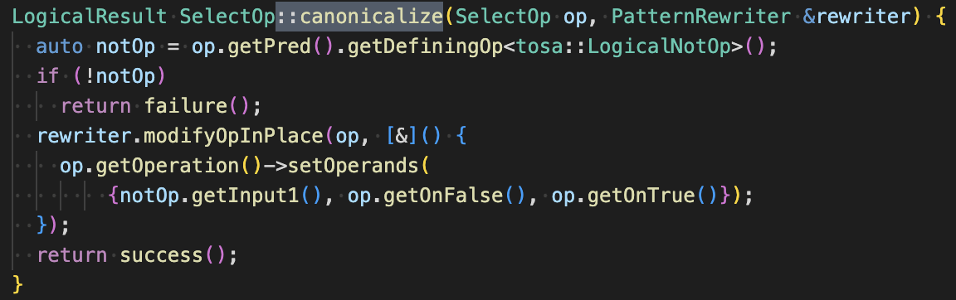
Ways to define canonicalization patterns
1. TableGen
2. Implement <OpClass>::canonicalize in C++ code (for more sophisticated cases)
https://github.com/llvm/llvm-project/blob/02dfbbff1937b3e2c1ee1cd4a5ad0a9f03ee23ea/mlir/lib/Dialect/Arith/IR/ArithCanonicalization.td#L35-L93
https://github.com/llvm/llvm-project/blob/02dfbbff1937b3e2c1ee1cd4a5ad0a9f03ee23ea/mlir/lib/Dialect/Tosa/IR/TosaCanonicalizations.cpp#L67C15-L76

Slide 21
Patterns
Common structure in MLIR.
There are the following patterns present in pass infrastructure:
fold and canonicalization (for canonicalizer pass)
rewrite (operation rewriting/replacement)
conversion (for conversion passes)
They are applied in random order and multiple times to make sure that IR is canonicalized/rewritten/converted.
More here:
Pattern Rewriting : Generic DAG-to-DAG Rewriting
https://mlir.llvm.org/docs/PatternRewriter/

Slide 22
Content
Available transformations and optimizations overview
Custom dialects
Writing a pass
MLIR connections with other languages
Debugging

Slide 23
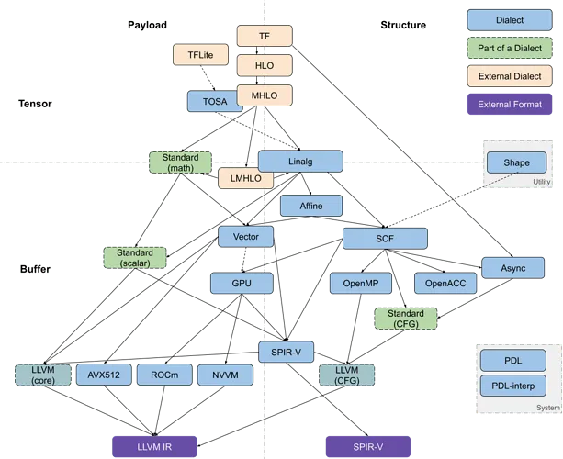
Dialects
One of possible ways to illustrate dialects in structured way
https://medium.com/sniper-ai/mlir-tutorial-create-your-custom-dialect-lowering-to-llvm-ir-dialect-system-1-1f125a6a3008

Slide 24
Creating a custom dialect
Dialect definition files are separated:
mlir/include/mlir/Dialect/<dialect_name> (include files)
mlir/include/mlir/Dialect/<dialect_name>/IR (operations include files)
mlir/include/mlir/Dialect/<dialect_name>/Transforms (transforms include files)
mlir/lib/Dialect/<dialect_name> (sources)
mlir/lib/Dialect/<dialect_name>/IR (operations sources)
mlir/lib/Dialect/<dialect_name>/Transforms (transforms sources)

Slide 25
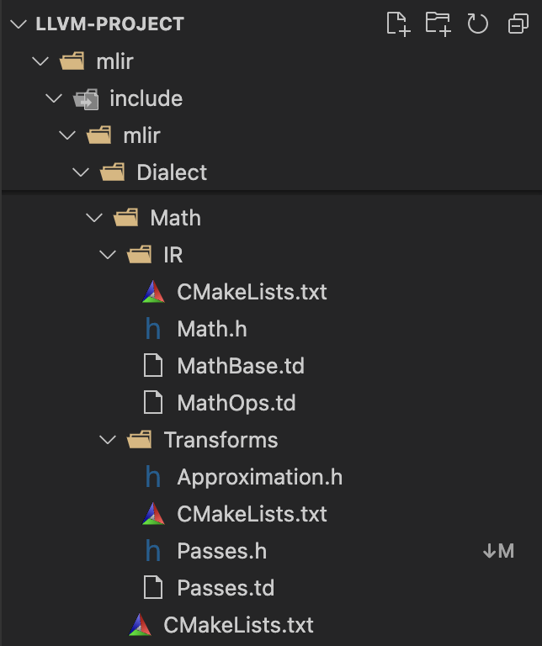
Learn by example: Math dialect
https://github.com/llvm/llvm-project/tree/main/mlir/include/mlir/Dialect/Math
IR:
Dialect description
Dialect attributes and types
Operations description
Transforms:
Dialect specific passes
other directories depend on dialect specifics

Slide 26
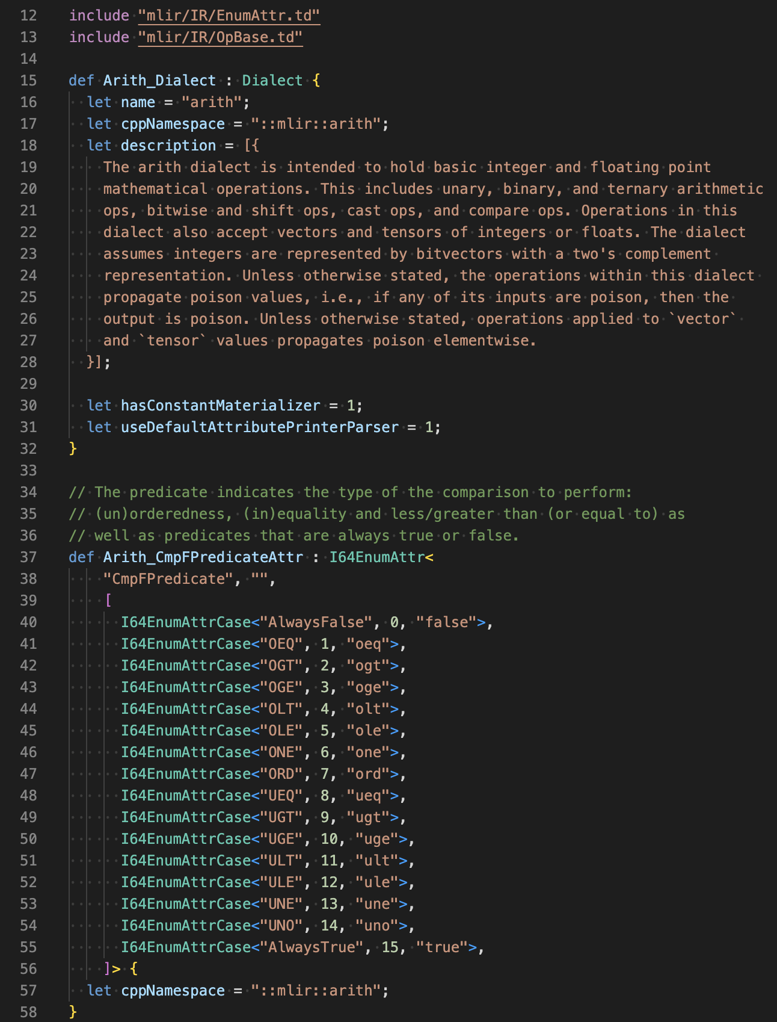
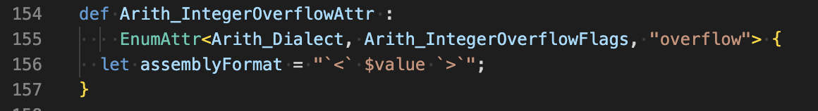
Dialect description
Docs: https://mlir.llvm.org/docs/DefiningDialects/AttributesAndTypes/
Example: https://github.com/llvm/llvm-project/blob/main/mlir/include/mlir/Dialect/Arith/IR/ArithBase.td

Slide 27
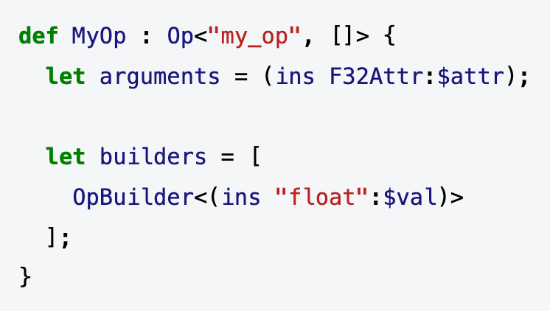
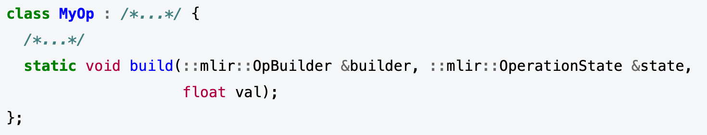
Operations definition
Operation Definition Specification (ODS)
Docs: https://mlir.llvm.org/docs/DefiningDialects/Operations/
TableGen definition
*Ops.td
Auto-generated code
*Ops.h.inc and *Ops.cpp.inc

Slide 28
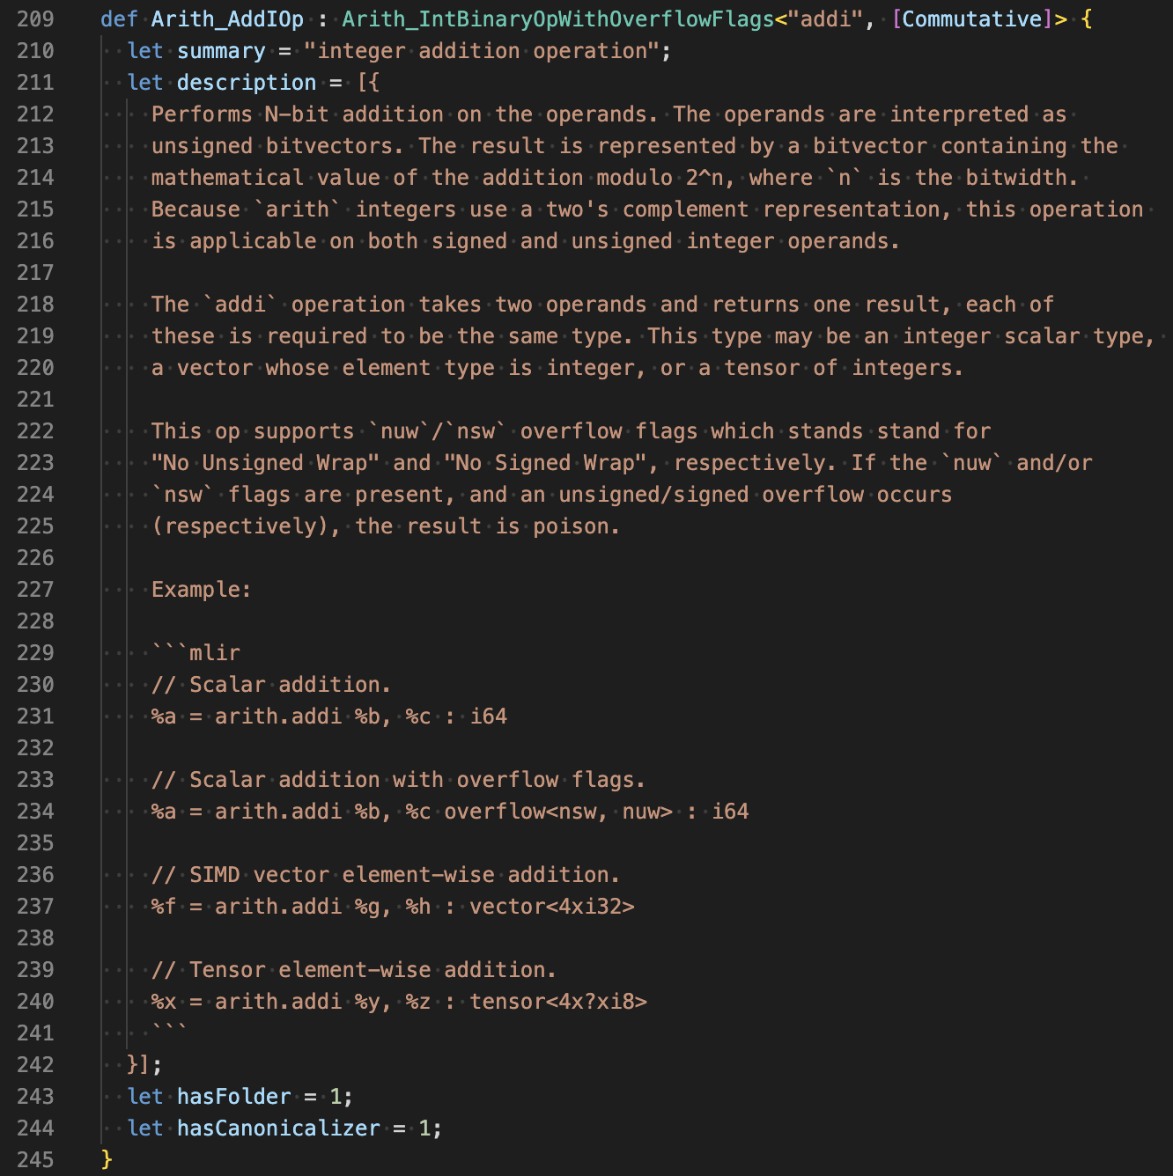
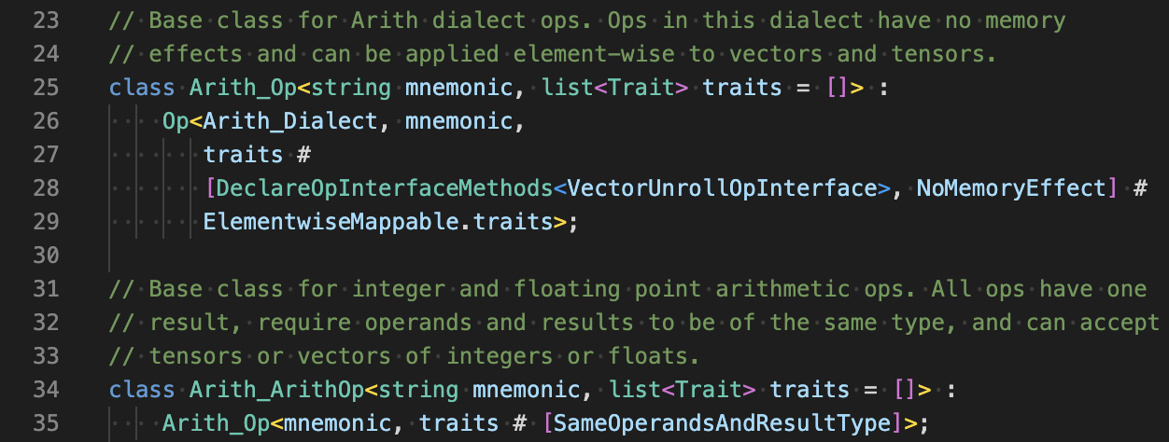
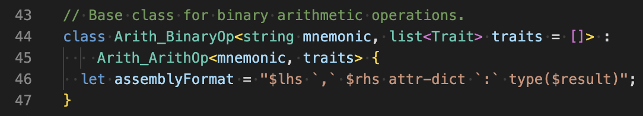
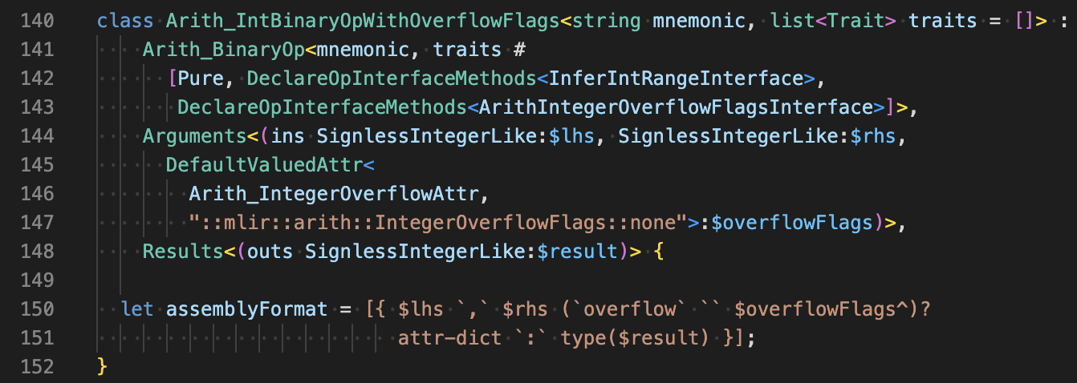
Arith AddI operation example
https://github.com/llvm/llvm-project/blob/76aa042dde6ba9ba57c680950f5818259ee02690/mlir/include/mlir/Dialect/Arith/IR/ArithOps.td#L209

Slide 29
Content
Available transformations and optimizations overview
Custom dialects
Writing a pass
MLIR connections with other languages
Debugging

Slide 30
Writing a pass
Pass manager
Docs: https://mlir.llvm.org/docs/PassManagement/

Slide 31
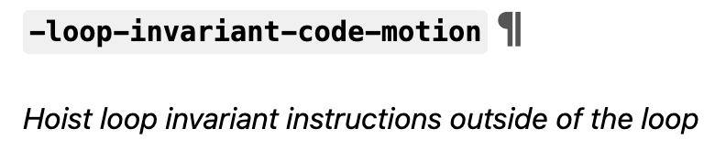
Pass writing by example: LICM
Loop Invariant Code Motion
https://mlir.llvm.org/docs/Passes/#-loop-invariant-code-motion

Slide 32
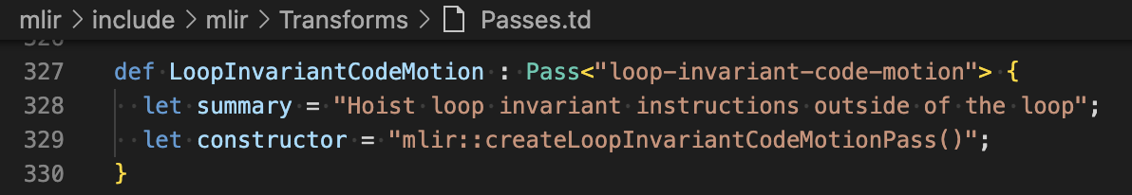
Pass writing by example: LICM definition in headers
TableGen Definition
https://github.com/llvm/llvm-project/blob/76aa042dde6ba9ba57c680950f5818259ee02690/mlir/include/mlir/Transforms/Passes.td#L336-L339
Header Definition
https://github.com/llvm/llvm-project/blob/76aa042dde6ba9ba57c680950f5818259ee02690/mlir/include/mlir/Transforms/Passes.h#L78-L80

Slide 33
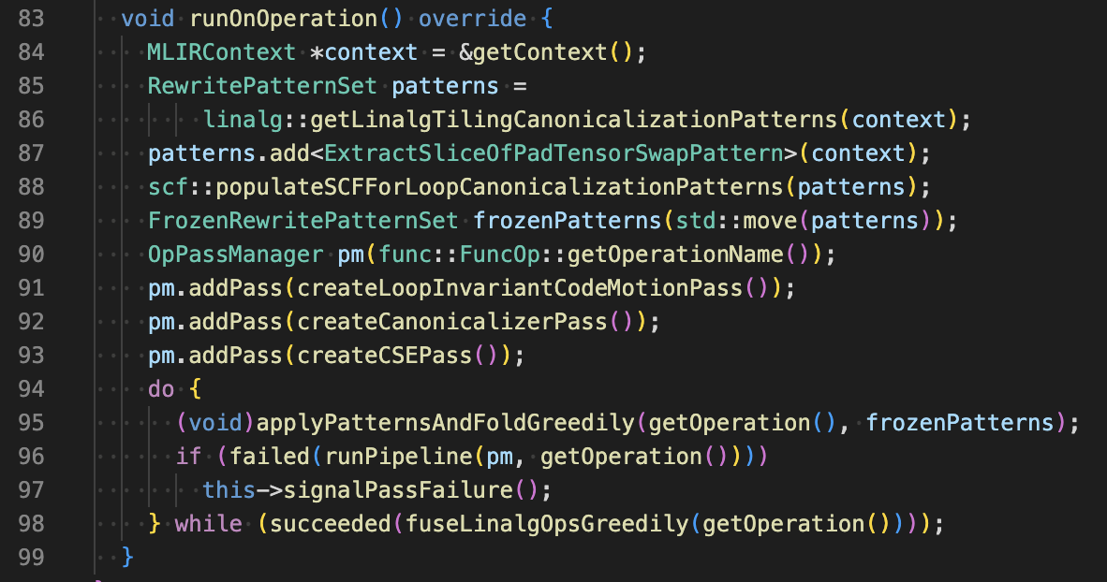
Pass writing by example: LICM usage
https://github.com/llvm/llvm-project/blob/76aa042dde6ba9ba57c680950f5818259ee02690/mlir/test/lib/Dialect/Linalg/TestLinalgFusionTransforms.cpp#L91C22-L91C28

Slide 34
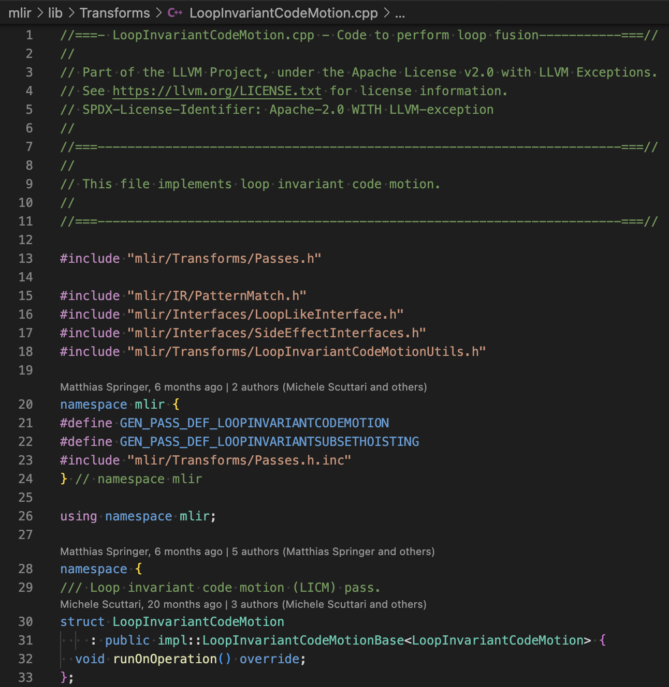
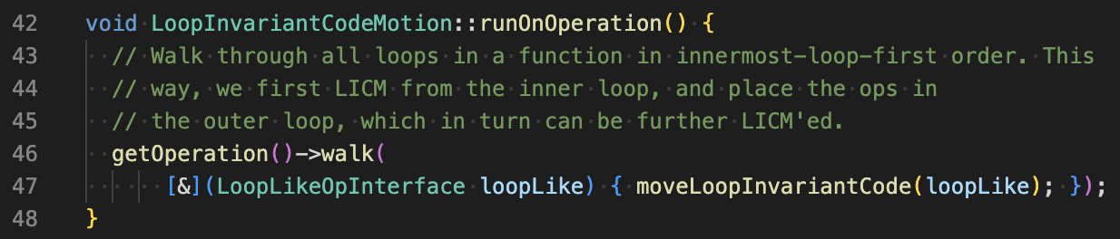
Pass writing by example: LICM implementation
runOnOperation is the main function to be implemented by pass developer

Slide 35
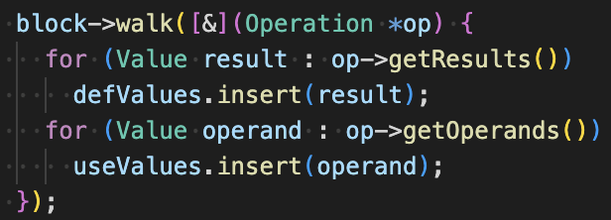
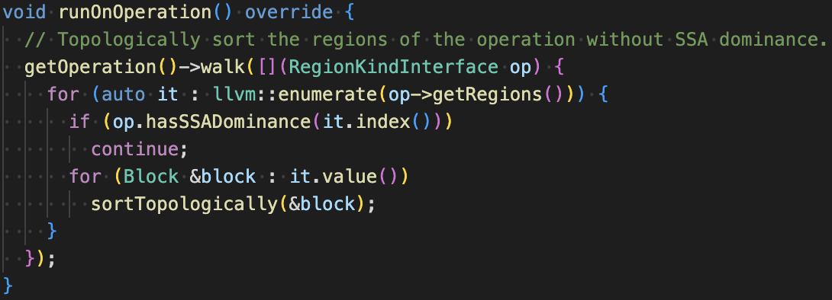
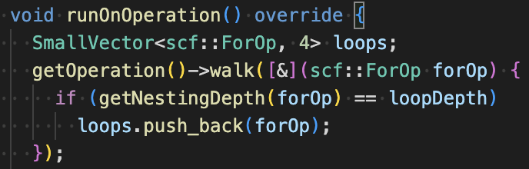
Operation walker
Walk through all operation within this operation
https://github.com/llvm/llvm-project/blob/ffc9a30938ae5c42c03f9c563db1465876b4def6/mlir/lib/Analysis/Liveness.cpp#L70
Walk through all operations implementing specific interface
https://github.com/llvm/llvm-project/blob/ffc9a30938ae5c42c03f9c563db1465876b4def6/mlir/lib/Transforms/TopologicalSort.cpp#L26
Walk through all operations of specific type (e.g. scf.for)
https://github.com/llvm/llvm-project/blob/ffc9a30938ae5c42c03f9c563db1465876b4def6/mlir/test/lib/Dialect/SCF/TestLoopUnrolling.cpp#L57

Slide 36
Rewind back to LLVM IR
LLVM IR passes classifications
Types
Analysis pass
Transformation pass
Utility pass
Run scope
Module pass
Function pass
Loop pass
…
What about MLIR classification?
It could be the same
but in addition to that usually people outline different classification rules
Operation walker gives an opportunity to run the pass on any operations

Slide 37
Content
Available transformations and optimizations overview
Custom dialects
Writing a pass
MLIR connections with other languages
Debugging

Slide 38
MLIR C API
Adds interoperability with many other programming languages
C (first of all), C++
C API: https://mlir.llvm.org/docs/CAPI/
Python
Built-in project: https://mlir.llvm.org/docs/Bindings/Python/
Rust
https://github.com/raviqqe/melior
others…
LLVM is written in C++. Why not C++? Why libraries usually choose C for interoperability?

Slide 39
C for interoperability
Why C over C++?
Mangled names in C++
OOP
Templates
Memory model differences
Pointers and references
Different allocation techniques
C is more common

Slide 40
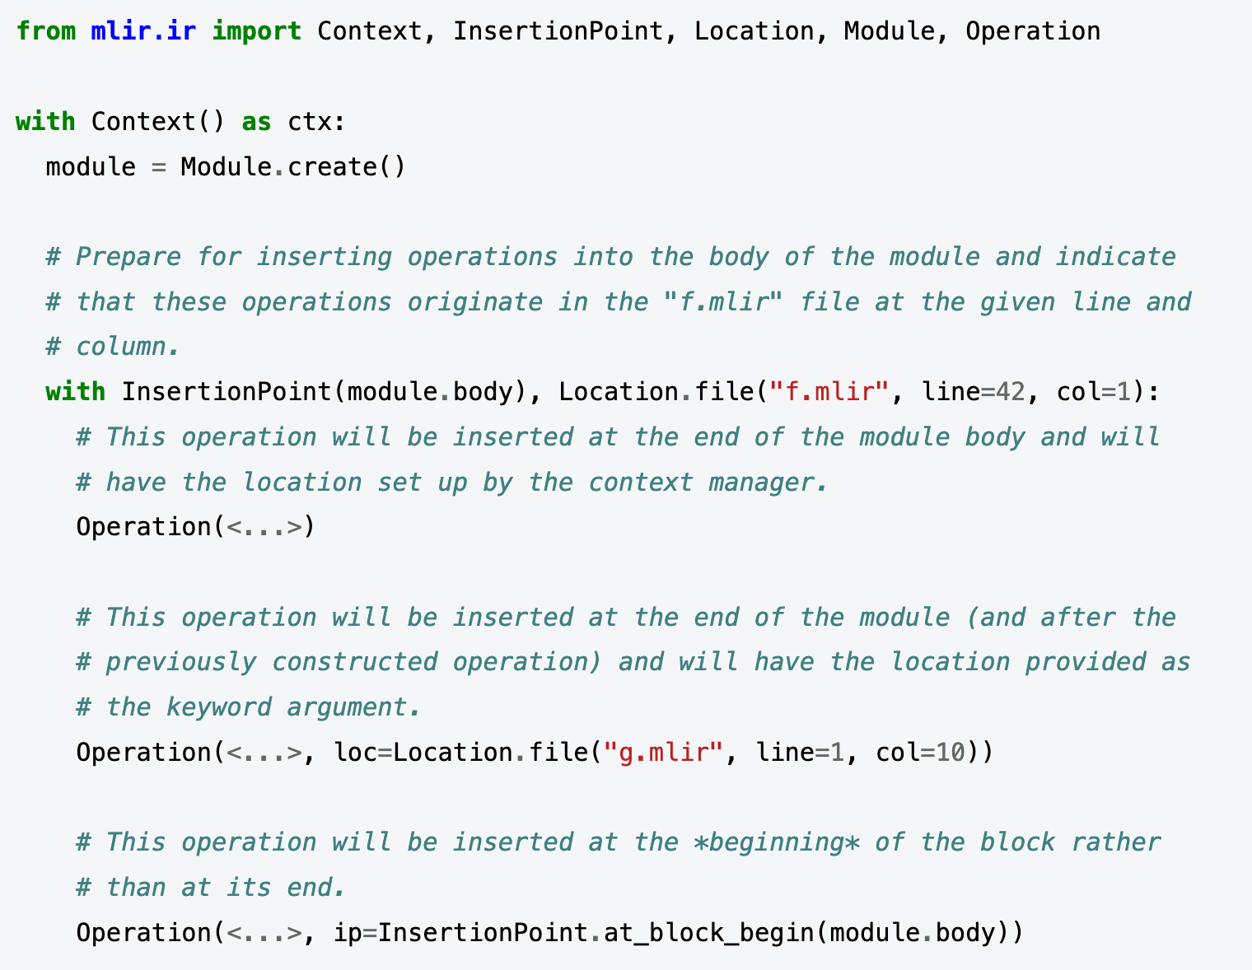
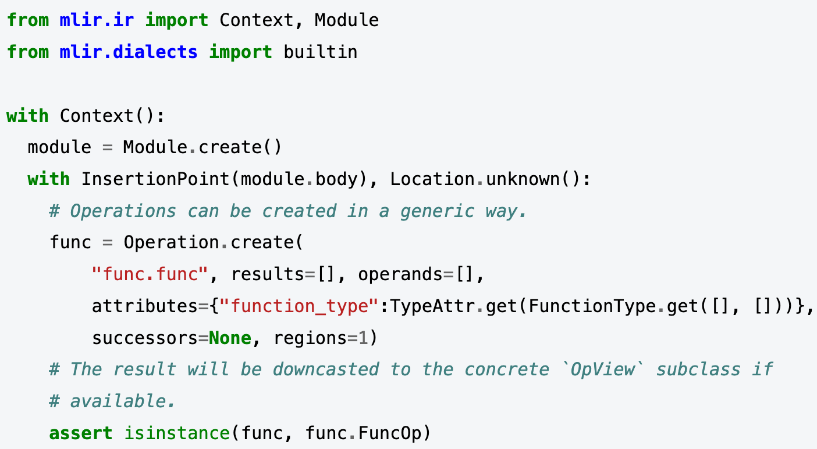
MLIR Python bindings
https://mlir.llvm.org/docs/Bindings/Python/

Slide 41
MLIR Python bindings
Projects who use:
mlir-aie
https://github.com/Xilinx/mlir-aie/blob/b8d512fa4368f5f9c77b76835323990e73cc099c/python/compiler/util.py#L414
xDSL
https://github.com/ingomueller-net/xdsl/blob/e67c2e00351cb7073dfa91a7e0e8e6e65bc60632/src/xdsl/mlir_converter.py#L129
Similar interface is exposed by languages that use MLIR (e.g. Triton)
https://github.com/microsoft/triton-shared/blob/e771c1e604c9c8883e50ed8f0e13c647156aa7c3/backend/compiler.py#L172
and others…

Slide 42
Content
Available transformations and optimizations overview
Custom dialects
Writing a pass
MLIR connections with other languages
Debugging

Slide 43
MLIR debugging
Debug sequence of passes
-mlir-print-ir-after-failure
-mlir-print-ir-before-all / -mlir-print-ir-after-all
Disable multithreading
-mlir-disable-threading
Print generic ops to pinpoint error in operation arguments
-mlir-print-op-generic
Use tools to find culprit operations in IR (e.g. mlir-reduce)
Reduce buggy IR to minimal one where the issue is still reproducible
https://mlir.llvm.org/docs/Tools/mlir-reduce/
other useful tips can be found here: https://mlir.llvm.org/getting_started/Debugging/

Slide 44
Core materials on MLIR
Official MLIR documentation: https://mlir.llvm.org/

Slide 45
Lab assignment #4
Write a pass in MLIR infrastructure
Deadline: May, 21
Where to seek help
https://mlir.llvm.org/docs/PassManagement/
Contact teachers

Slide 46
Next time
Python internals
AST
bytecode (IR)
Interpreter
JIT
…

Slide 47

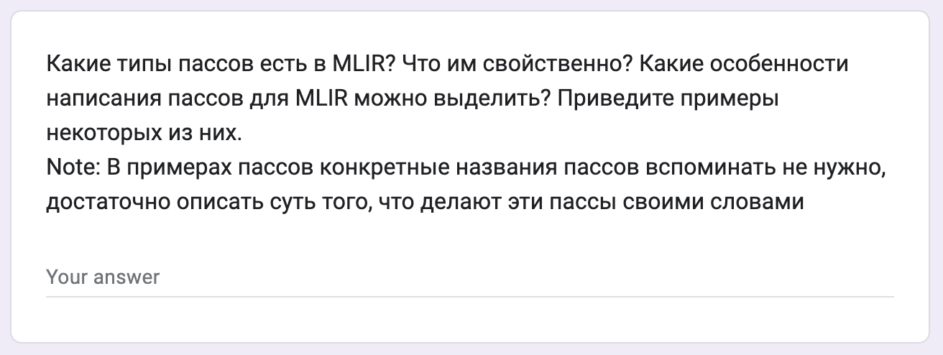
Test
https://forms.gle/1W5MqDQNfpvq35sUA
Submission time: 10 minutes
Backup: me@gooddoog.ru

Slide 48

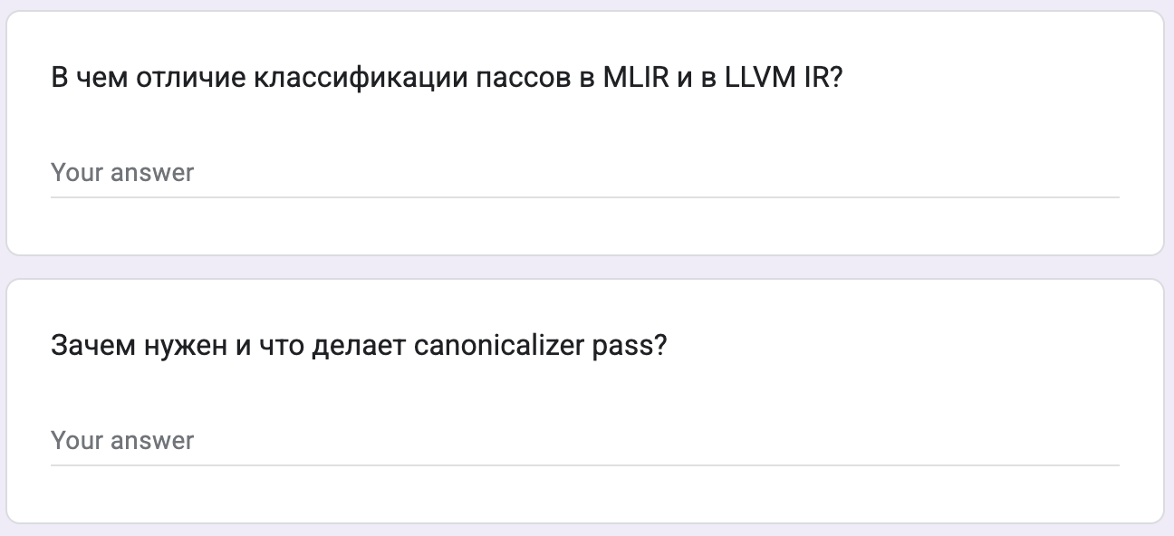
Test
https://forms.gle/HbN5qJU1sViVkSSP6
Submission time: 10 minutes
Backup: me@gooddoog.ru

Slide 49
Extra materials
How to build a compiler with LLVM and MLIR: https://www.youtube.com/playlist?list=PLlONLmJCfHTo9WYfsoQvwjsa5ZB6hjOG5
2019 EuroLLVM Developers’ Meeting: T. Shpeisman & C. Lattner “MLIR: Multi-Level Intermediate Representation for Compiler Infrastructure” https://www.youtube.com/watch?v=qzljG6DKgic
2023 LLVM Dev Mtg - MLIR Is Not an ML Compiler, and Other Common Misconceptions: https://www.youtube.com/watch?v=lXAp6ZAWyBY
MLIR CodeGen Dialects for Machine Learning Compilers: https://www.lei.chat/posts/mlir-codegen-dialects-for-machine-learning-compilers/
MLIR: Scaling Compiler Infrastructure for Domain Specific Computation: https://rcs.uwaterloo.ca/~ali/cs842-s23/papers/mlir.pdf
MLIR: A Compiler Infrastructure for the End of Moore’s Law: https://arxiv.org/pdf/2002.11054
Triton: An Intermediate Language and Compiler for Tiled Neural Network Computations: https://www.eecs.harvard.edu/~htk/publication/2019-mapl-tillet-kung-cox.pdf

